Slide 1
FOOD REQIREMENT ANALYSIS IN AREA Using clustering algorithm
Developed by:
Bindu D.P
Kavita L Kusagatti
Pooja
Sanskriti Kumar

Slide 2
INTRODUCTION
There is no single way to measure food security, the concept itself being rather elusive. Analysis of food security by WFP generally uses food consumption as the entry point. Food consumption measured in kilocalories is the gold standard for measuring consumption, and often considered to be one of the gold standards for food security- but the collection of detailed food intake data is difficult and time consuming
WFP’s goal is to have a standard food consumption data collection instrument and analysis approach that is flexible enough for different needs and contexts, while standard enough to have equally applicable analysis techniques and equally interpretable results, and also one that can be implemented in the field in a reasonable data collection and analysis timeframe. There are several alternative ways to collect and analyze food consumption information using indicators that are proxy for actual caloric intake and diet quality.
Analysis of dietary diversity and food frequency can be done in several ways, each with its own specific aims - looking at consumption from different angles, and with different strengths and weaknesses. Building composite scores which measure food frequency and/or dietary diversity is one of the more explored and tested methodologies. Well defined examples include the FANTA dietary diversity score and the DHS Food groups indicator. There are several other indicators found throughout the literature.

Slide 3
Some of the advantages and drawbacks are given below:
Advantages of the PCA and Cluster Analysis methodology include:
The ability to perform a context specific and in-depth analysis of food consumption.
The option to include other non-consumption indicators into the PCA and cluster analysis.
The ability of cluster analysis to identify households with similar specific consumption patterns.
Cluster analysis is able to capture both Dietary Diversity and Food Frequency.
However, the drawbacks include:
The analysis on a single dataset cannot be re-produced, even by the same analyst. The use of randomly selected ‘canters’ in the cluster analysis prevent the exact reproduction of clusters between analyses.
A certain level of subjectivity is inherent in the creation (cluster analysis parameters, final number of clusters) and interpretation of the clusters (both a strength and weakness of the analysis).
Due to the fact that part of this analysis is based on the interpretation of the analyst of the clusters, the comparability of results between surveys is difficult and not statistically valid.
The analysis of the data, to the non-statistician, is somewhat of a ‘black box’.

Slide 4
OVERVIEW:
Clustering is one of the most common exploratory data analysis technique used to get an intuition about the structure of the data. It can be defined as the task of identifying subgroups in the data such that data points in the same subgroup (cluster) are very similar while data points in different clusters are very different. In other words, we try to find homogeneous subgroups within the data such that data points in each cluster are as similar as possible according to a similarity measure such as euclidean-based distance or correlation-based distance. The decision of which similarity measure to use is application-specific.Clustering analysis can be done on the basis of features where we try to find subgroups of samples based on features or on the basis of samples where we try to find subgroups of features based on samples. We’ll cover here clustering based on features. Clustering is used in market segmentation; where we try to find customers that are similar to each other whether in terms of behaviours or attributes, image segmentation/compression; where we try to group similar regions together, document clustering based on topics, etc.Unlike supervised learning, clustering is considered an unsupervised learning method since we don’t have the ground truth to compare the output of the clustering algorithm to the true labels to evaluate its performance. We only want to try to investigate the structure of the data by grouping the data points into distinct subgroups.
PURPOSE
Our aim from the project is to make use of TensorFlow, scikit and flask libraries from python to extract the libraries for machine learning for the food requirement analysis. Then, to make out which country is the highest producer , for that we have used K-Means clustering method.

Slide 5
Existing problem
In general, Our world population is expected to grow from 7.3 billion today to 9.7 billion by 2050. Finding solutions for feeding the growing world population has become a hot topic for food and agriculture organizations, entrepreneurs and philanthropists. These solutions range from changing the way we grow our food to changing the way we eat. To make things harder, the world's climate is changing and it is both affecting and affected by the way we grow our food – agriculture. Hence, it is necessary that we analyze thfood production and act faster rather than repenting later.
Proposed Solution
The main objective of this project is to help the agriculturist who are suffering from the crop loss and also those who are facing the food shortage in their particular area.The main aim of this project is to perform in-depth EDA of the data and figure out the annual produce of different countries, analyse lead producers of food.We also perform clustering algorithms to classify countries based on productivity scale.

Slide 6
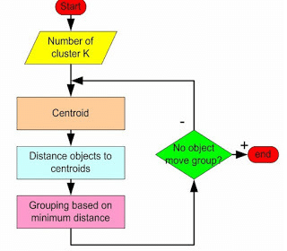
Flow Chart

Slide 7
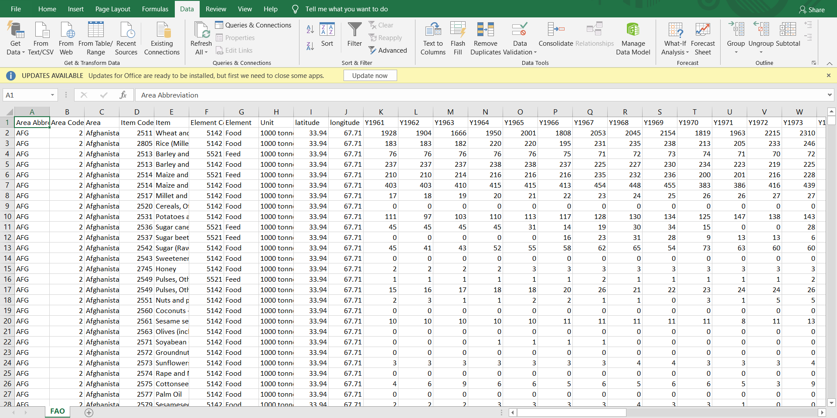
EXPERIMENTAL ANALYSIS
In this project, the dataset we downloaded is from some dataset available on kaggle. It contains Area code Country name abbreviation Area - County name Item - Food item Element - Food or Feed Latitude - geographic coordinate that specifies the north–south position of a point on the Earth's surface Longitude - geographic coordinate that specifies the east-west position of a point on the Earth's surface Production per year - Amount of food item produced in 1000 tonnes.

Slide 8
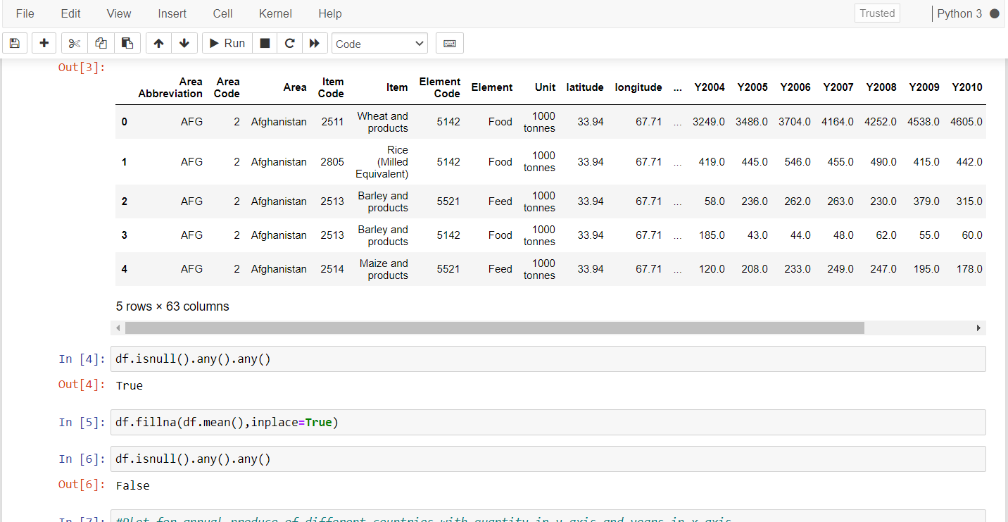
IMPLEMENTATION
We have imported libraries and also the dataset. Then we check for the null values. If there are null values , we will drop those null values by using the command. Then we have Plot for annual produce of different countries with quantity in y-axis and years in x-axis.
import pandas as pd
import numpy as np
import matplotlib.pyplot as plt

Slide 9
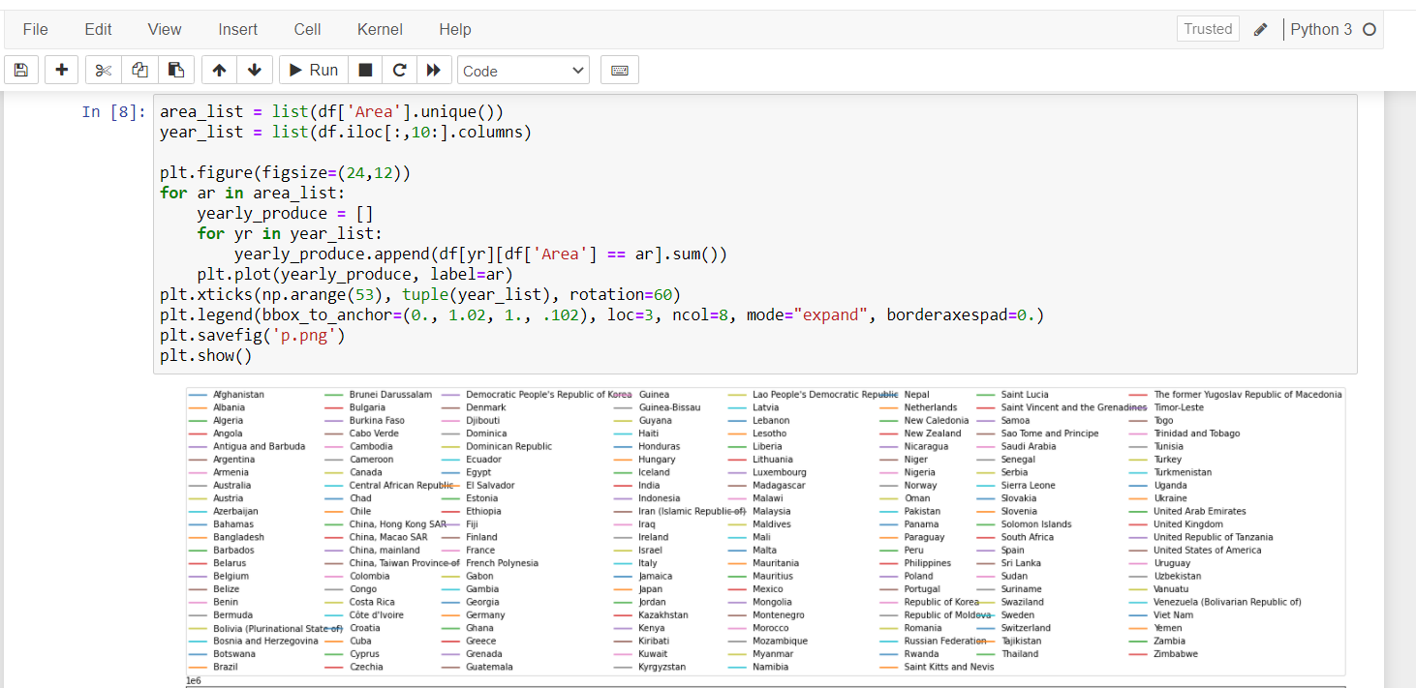
Plot for annual produce of different countries with quantity in y-axis and years in x- axis.

Slide 10
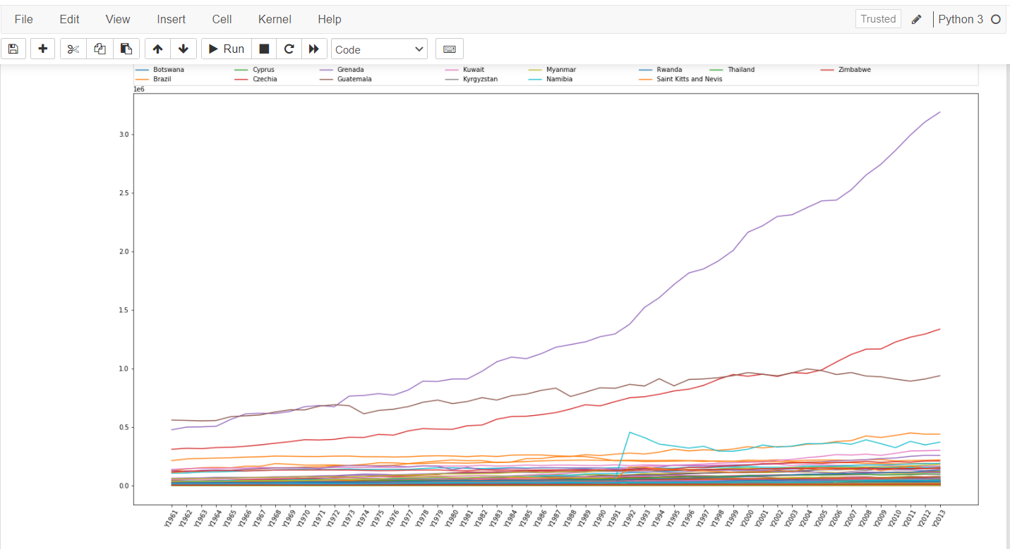
p.png diagram

Slide 11
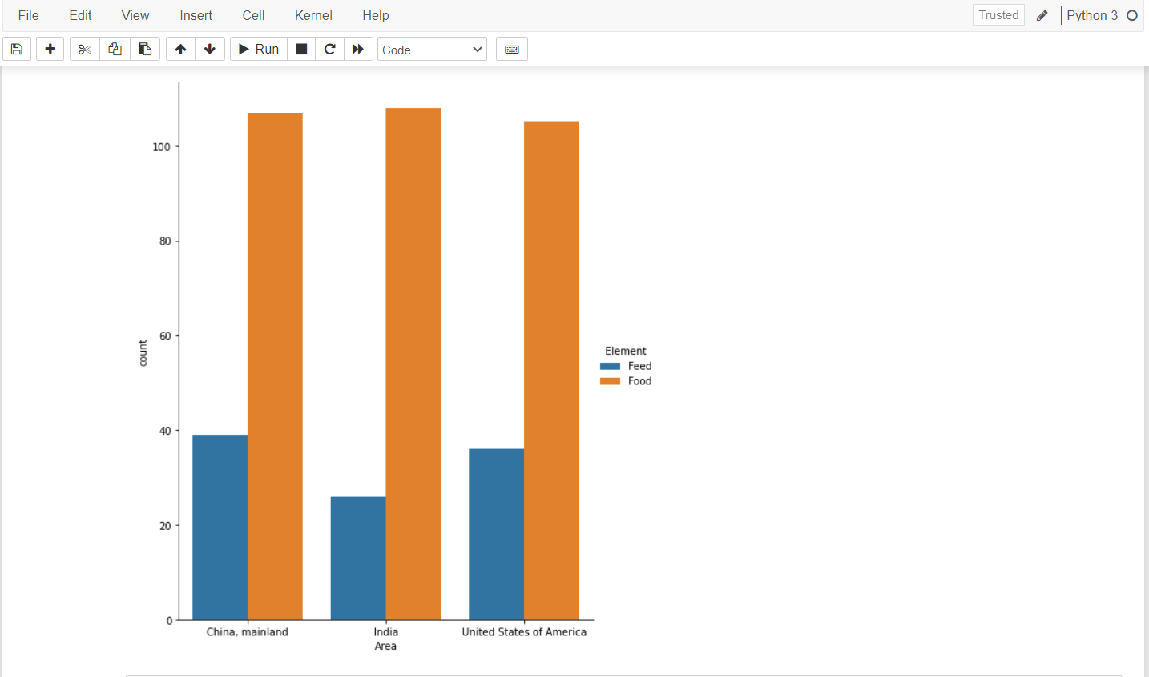
Food and feed plot for the largest producers(India, USA, China)

Slide 12
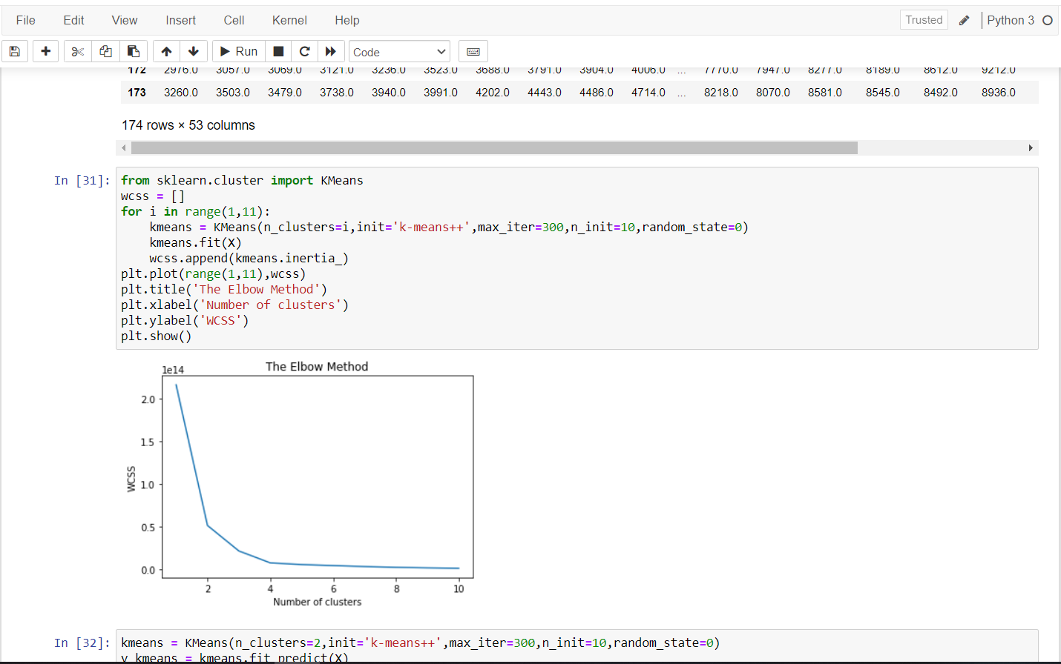
Elbow method

Slide 13
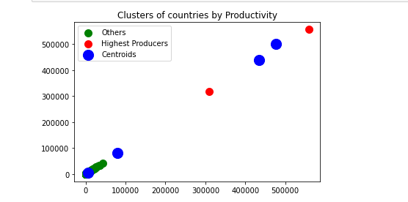
CONCLUSION
Clustering is techniques by which large dataset are dividing into small data collections that are called clusters. There are number Of algorithms that work well for clustering the data that can divide a dataset in clusters. Survey on k-means clustering algorithm proposes different advantage and disadvantage in different k-means application algorithm. It clearly shows that clustering can be used effectively to extract the knowledge in precision agriculture field. Traditional k-mean method is combined with Hierarchical algorithm for the centroid selection.

Slide 14
THANK YOU

